Slide 1
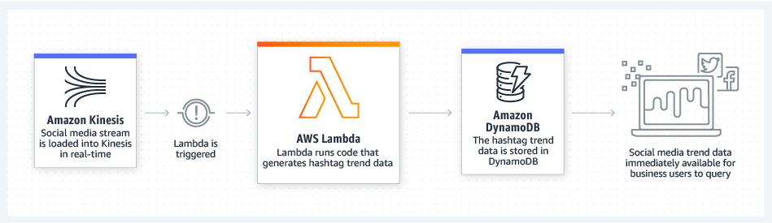
AWS Lambda Use Cases
Real-Time Stream Processing
You can use AWS Lambda and Amazon Kinesis to process real-time
streaming data for application activity tracking, transaction order
processing, click stream analysis, data cleansing, metrics generation,
log filtering, indexing, social media analysis, and IoT device data telemetry
and metering.

Slide 2

AWS Lambda Use Cases
Localytics processes billions of data points in real-time, and uses Lambda to process historical and live data stored in S3 or streamed from Kinesis.

Slide 3
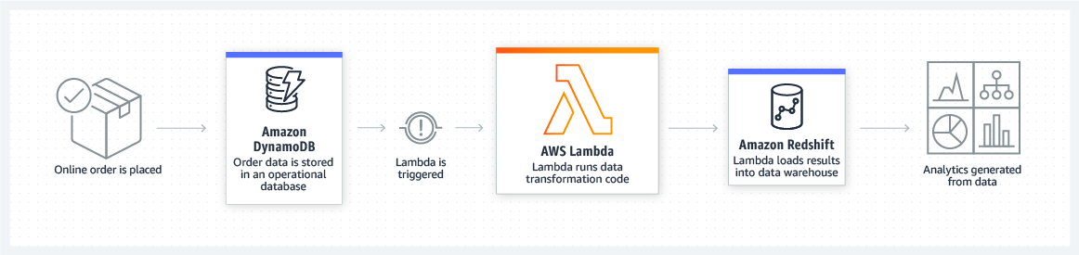
AWS Lambda Use Cases
Extract, Transform, Load
You can use AWS Lambda to perform data validation, filtering, sorting,
or other transformations for every data change in a DynamoDB table
and load the transformed data to another data store.

Slide 4

AWS Lambda Use Cases
Zillow uses Lambda and Kinesis to track a subset of mobile metrics in realtime.
With Kinesis and Lambda, we were able to develop and deploy
a cost effective solution in two weeks.

Slide 5
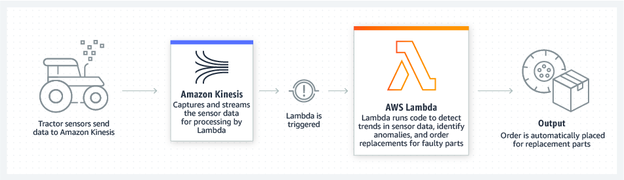
AWS Lambda Use Cases
Backends
You can build serverless backends using AWS Lambda to handle web,
mobile, Internet of Things (IoT), and 3rd party API requests.
IOT Backends

Slide 6
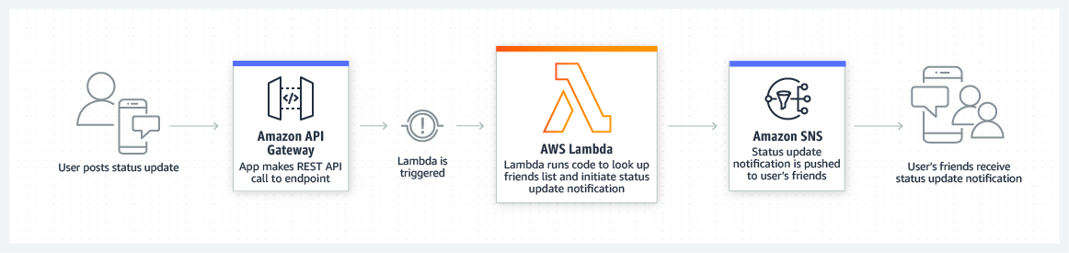
AWS Lambda Use Cases
Mobile Backends
You can build backends using AWS Lambda and Amazon API Gateway
to authenticate and process API requests. Lambda makes it easy to create
rich, personalised app experiences.

Slide 7

AWS Lambda Use Cases
Bustle runs a serverless backend for its Bustle iOS app and websites using AWS Lambda and Amazon API Gateway. Serverless architectures allow Bustle to never have to deal with infrastructure management, so every engineer can focus on building out new features and innovating.

Slide 8
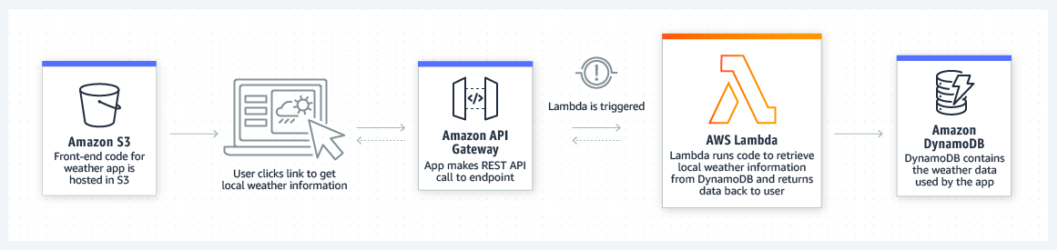
AWS Lambda Use Cases
Web Applications
By combining AWS Lambda with other AWS services, developers can build
powerful web applications that automatically scale up and down and run
in a highly available configuration across multiple data centres –
with zero administrative effort required for scalability, back-ups or
multi-data center redundancy.

Slide 9

AWS Lambda Case Studies
The Coca-Cola Company, an American multinational beverage corporation, used AWS Lambda and AWS Step Functions to build a cost-effective serverless solution.

Slide 10
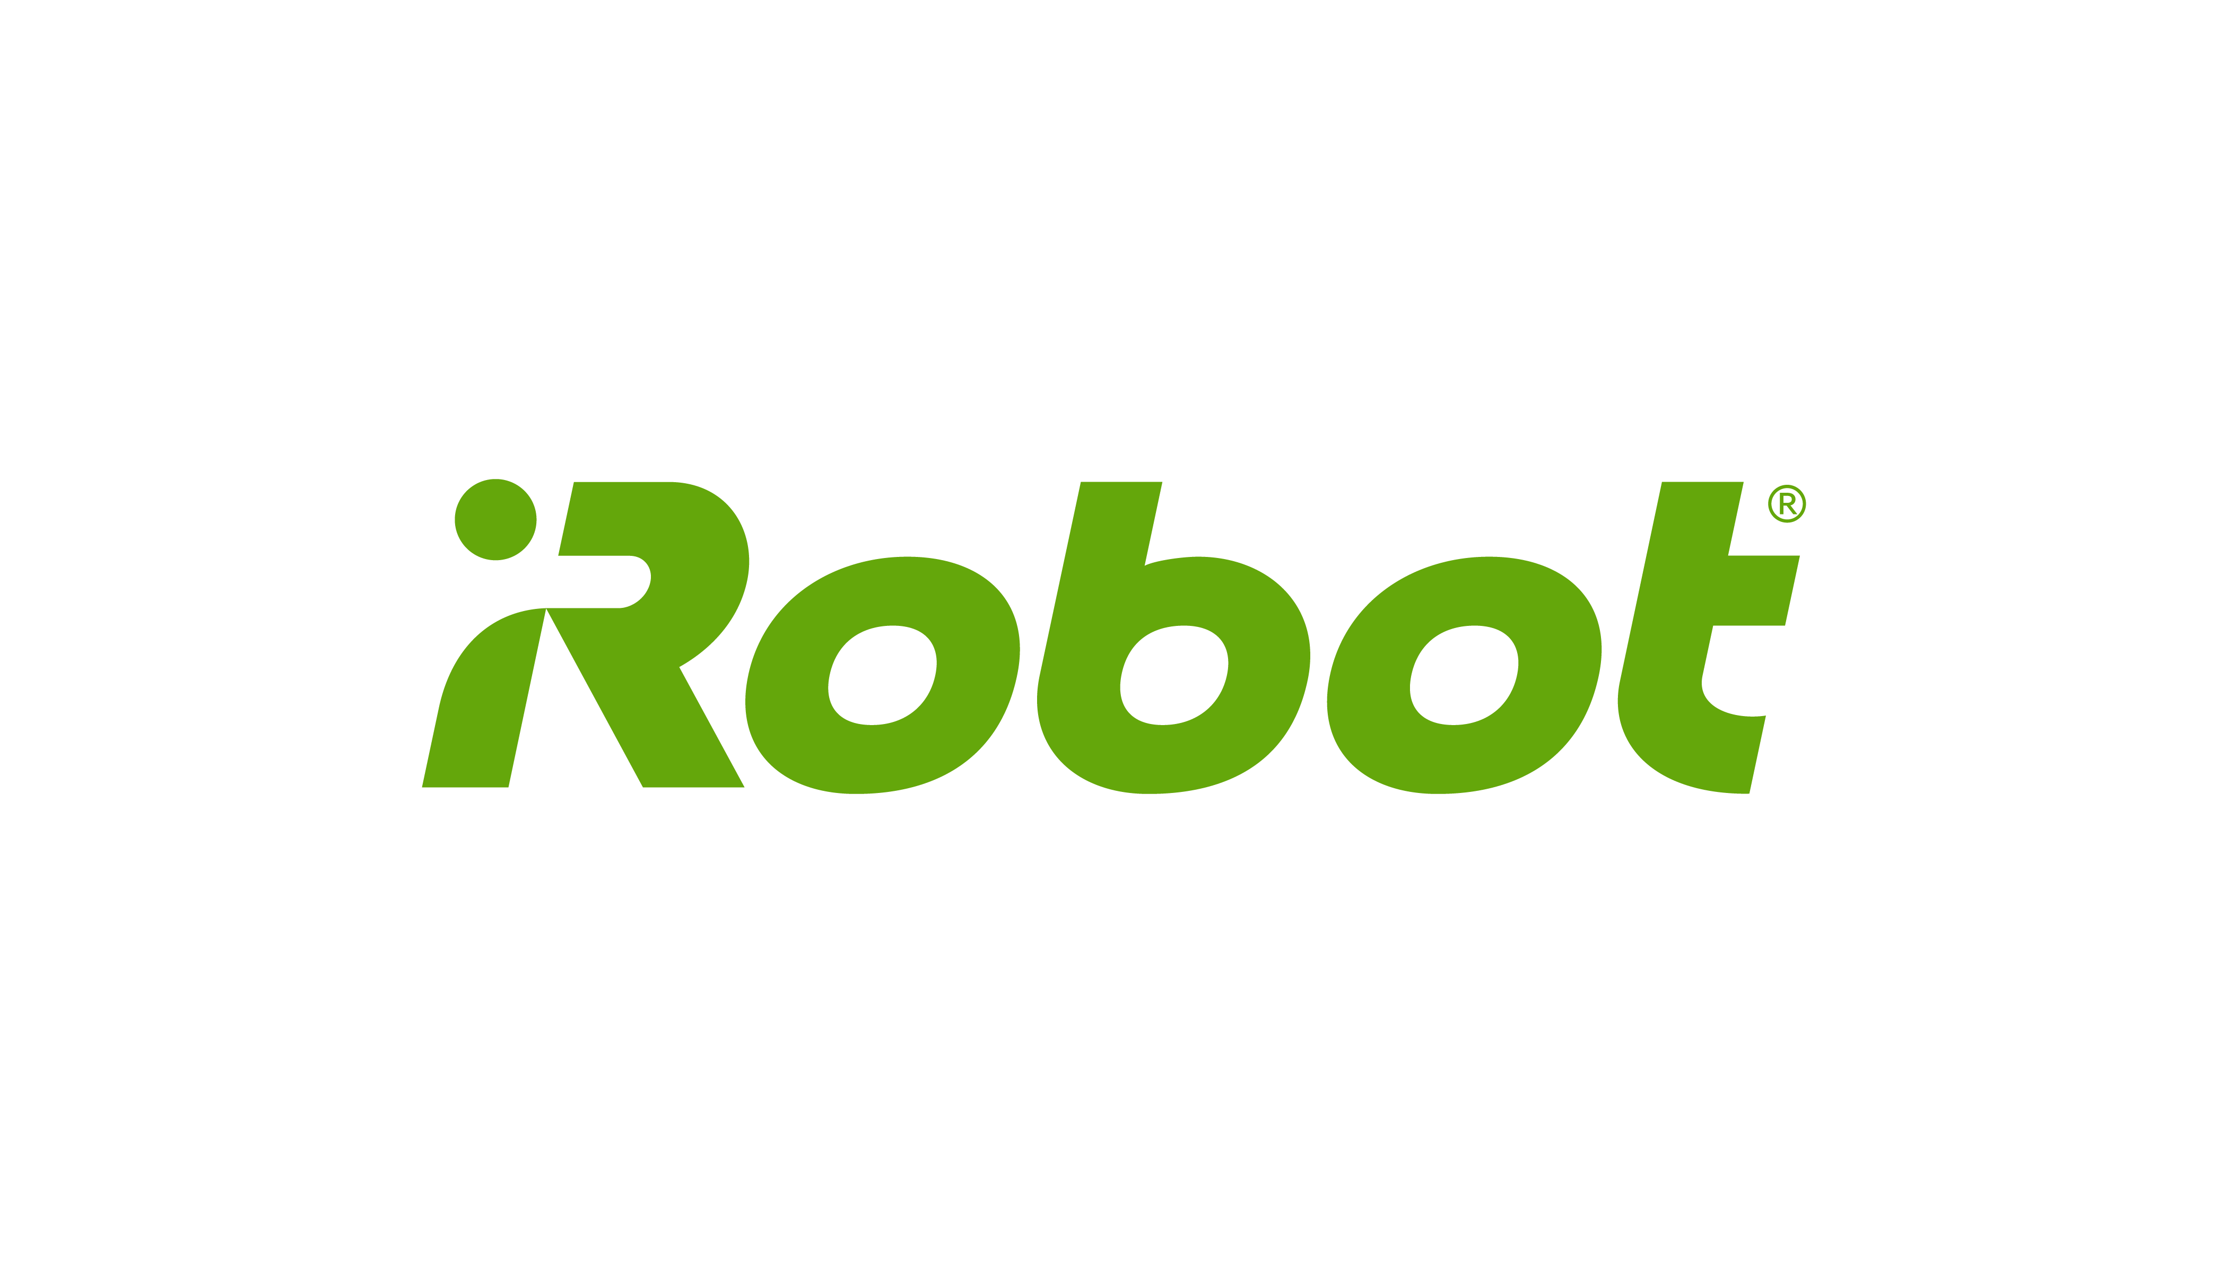
AWS Lambda Case Studies
iRobot, a leading global consumer robot company, is building the next generation of connected devices for the smart home using a serverless architecture.

Slide 11

AWS Lambda Case Studies
Benchling, a life science software company, created a technique that researchers use to modify parts of a genome with extreme precision using serverless architecture.

Slide 12

AWS Lambda Case Studies
Thomson Reuters uses AWS Lambda to process up to 4,000 events per second for its usage analytics service, and it took five months to deploy into production.

Slide 13
What Languages?
Node.js
Java
Python
C#
Go

Slide 14
How is Lambda Priced?
Number of requests
First 1 million requests are free. $0.20 per 1 million requests thereafter.
Duration
Duration is calculated from the time your code begins executing until
it returns or otherwise terminates, rounded up to the nearest 100ms.
The price depends on the amount of memory you allocate to your
function. You are charged $0.00001667 for every GB-second used.

Slide 15
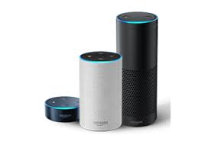
Amazon Echo

Slide 16
Lambda - Exam Tips
Lambda scales out (not up) automatically
Lambda functions are independent, 1 event = 1 function
Lambda is serverless
Know what services are serverless!
Lambda functions can trigger other lambda functions,
1 event can = x functions if functions trigger other functions
Architectures can get extremely complicated, AWS X-Ray
allows you to debug what is happening
Lambda can do things globally, you can use it to back up
S3 buckets to other S3 buckets etc
Know your triggers

Slide 17
Amazon API Gateway
Create, maintain, and secure APIs at any scale

Slide 18

Amazon API Gateway is a fully managed service that makes it easy for developers to create, publish, maintain, monitor, and secure APIs at any scale. With a few clicks in the AWS Management Console, you can create REST and WebSocket APIs that act as a “front door” for applications to access data, business logic, or functionality from your backend services, such as workloads running on Amazon Elastic Compute Cloud (Amazon EC2), code running on AWS Lambda, any web application, or real-time communication applications.

Slide 19
API Gateway handles all the tasks involved in accepting and processing up to hundreds of thousands of concurrent API calls, including traffic management, authorisation and access control, monitoring, and API version management. API Gateway has no minimum fees or startup costs. You pay only for the API calls you receive and the amount of data transferred out and, with the API Gateway tiered pricing model, you can reduce your cost as your API usage scales.

Slide 20





What is an API?
An API is an Application Programming Interface

Slide 21






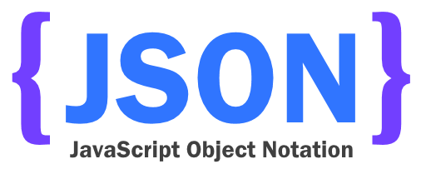
Travel Website Example

Slide 22
Types of APIs
REST APIs (REpresentational State Transfer)
Uses JSON
{
“id” : “51262c865ca358946be09d77”,
“firstname” : “John”,
“surname” : “Smith”
}
SOAP APIs (Simple Object Access Protocol)
Uses XML
<quiz>
<question>
Who was the forty-second president
of the USA?
</question>
<answer>
William Jefferson Clinton
</answer>
</quiz>
You can configure API Gateway as a SOAP web service
passthrough

Slide 23
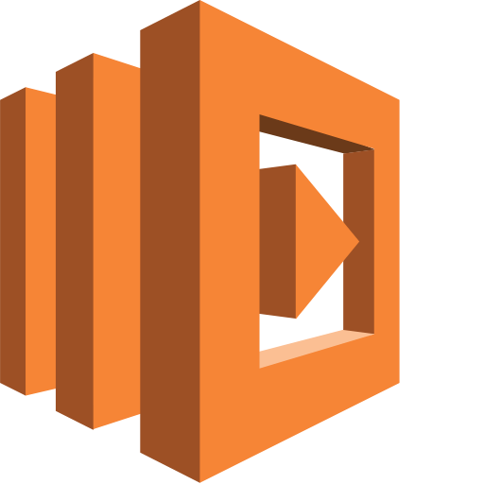

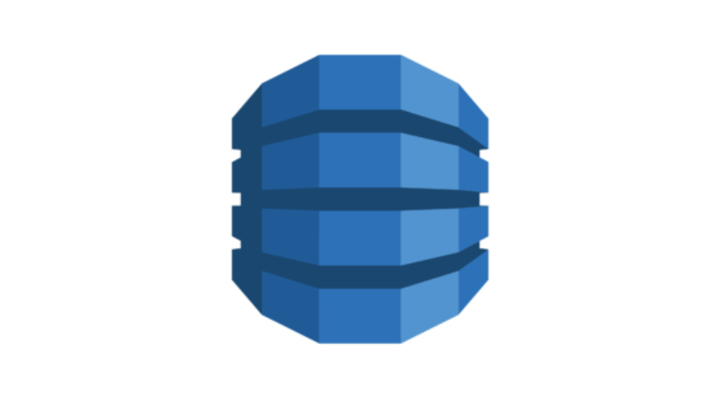
API Gateway

Slide 24
What can API Gateway do?
Expose HTTPS endpoints to define a RESTful API
Serverless-ly connect to services like Lambda & DynamoDB
Send each API endpoint to a different target
Run efficiently with low cost
Scale effortlessly
Track and control usage by API key
Throttle requests to prevent attacks
Connect to CloudWatch to log all requests for monitoring
Maintain multiple versions of your API

Slide 25
How do I configure
API Gateway?
Define an API (container)
Define Resources and nested Resources (URL paths)
For each Resource:
Select supported HTTP methods (verbs)
Set security
Choose target (such as EC2, Lambda, DynamoDB, etc.)
Set request and response transformations
Deploy API to a stage
Uses API Gateway domain, by default
Can use custom domain
Now supports AWS Certificate Manager: free SSL/TLS certs!

Slide 26
What is API Caching?
You can enable API Caching in Amazon API Gateway to cache your
endpoint’s response. With caching, you can reduce the number of calls
made to your endpoint and also improve the latency of the requests to
your API. When you enable caching for a stage, API Gateway caches
responses from your endpoint for a specified time-to-live (TTL) period,
in seconds. API Gateway then responds to the request by looking up the
endpoint response from the cache instead of making a request to your
endpoint.

Slide 27
API Gateway Caching

Slide 28
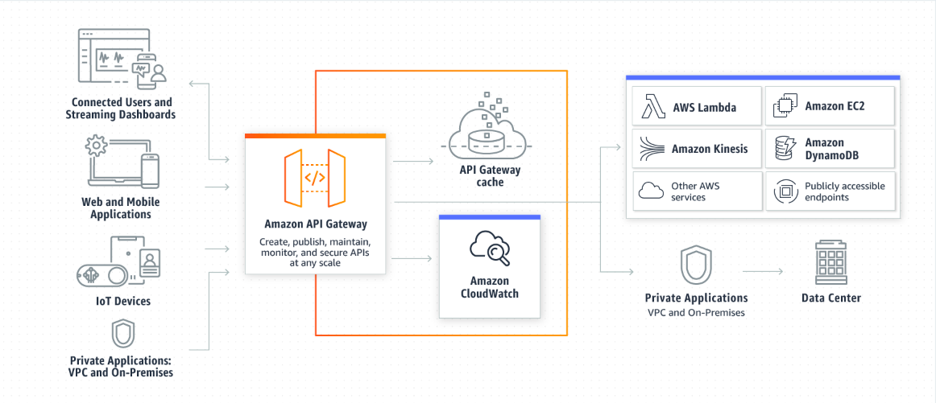
How API Gateway Works?

Slide 29
API Gateway Benefits
Efficient API development
Easy monitoring
Performance at any scale
Cost savings at scale
Flexible security controls
Restful API endpoints
Serverless APIs
WebSocket APIs

Slide 30
Same Origin Policy
In computing, the same-origin policy is an important concept in the web
application security model. Under the policy, a web browser permits scripts
contained in a first web page to access data in a second web page, but
only if both web pages have the same origin.
This is done to prevent Cross-Site Scripting (XSS) attacks
Enforced by web browsers
Ignored by tools like Postman and curl

Slide 31
CORS
Cross-Origin Resource Sharing (CORS) is one way the server at the other
end (not the client code in the browser) can relax the same-origin policy.
Cross-Origin Resource Sharing (CORS) is a mechanism that allows
restricted resources (e.g. fonts) on a web page to be requested from
another domain outside the domain from which the first resource
was served.

Slide 32
Versioning
When you use versioning in AWS Lambda, you can publish one or more
versions of your Lambda function. As a result, you can work with different
variations of your Lambda function in your development workflow, such as
development, beta, and production.
Each Lambda function version has a unique Amazon Resource Name (ARN).
After you publish a version, it is immutable (that is, it can’t be changed).
AWS Lambda maintains your latest function code in the $LATEST version.
When you update your function code, AWS Lambda replaces the code in the
$LATEST version of the Lambda function.
You can refer to this function using its Amazon Resource Name (ARN).
There are two ARNs associated with this initial version:
Qualified ARN - The function ARN with the version suffix
arn:aws:lambda:aws-region:acct-id:function:helloworld:$LATEST
Unqualified ARN - The function ARN without the version suffix
arn:aws:lambda:aws-region:acct-id:function:helloworld

Slide 33
Alias
After initially creating a Lambda function (the $LATEST version), you can
publish a version 1 of it. By creating an alias named PROD that points to
version 1, you can now use the PROD alias to invoke version 1 of the
Lambda function.
Now, you can update the code (the $LATEST version) with all of your
improvements, and then publish another stable and improved version
(version 2). You can promote version 2 to production by remapping the
PROD alias so that it points to version 2. If you find something wrong,
you can easily roll back the production version to version 1 by remapping
the PROD alias so that it points to version 1.

Slide 34
Version Control with Lambda
Can have multiple versions of Lambda functions
Latest version will use $latest
Qualified version will use $latest, unqualified will not have it
Versions are immutable (cannot be changed)
Can split traffic using aliases to different versions
Cannot split traffic with $latest, instead create an alias to latest

Slide 35
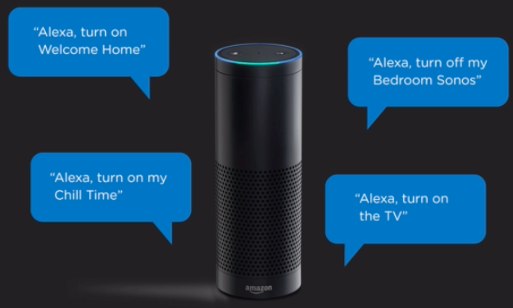
Introduction to Alexa

Slide 36





Slide 37
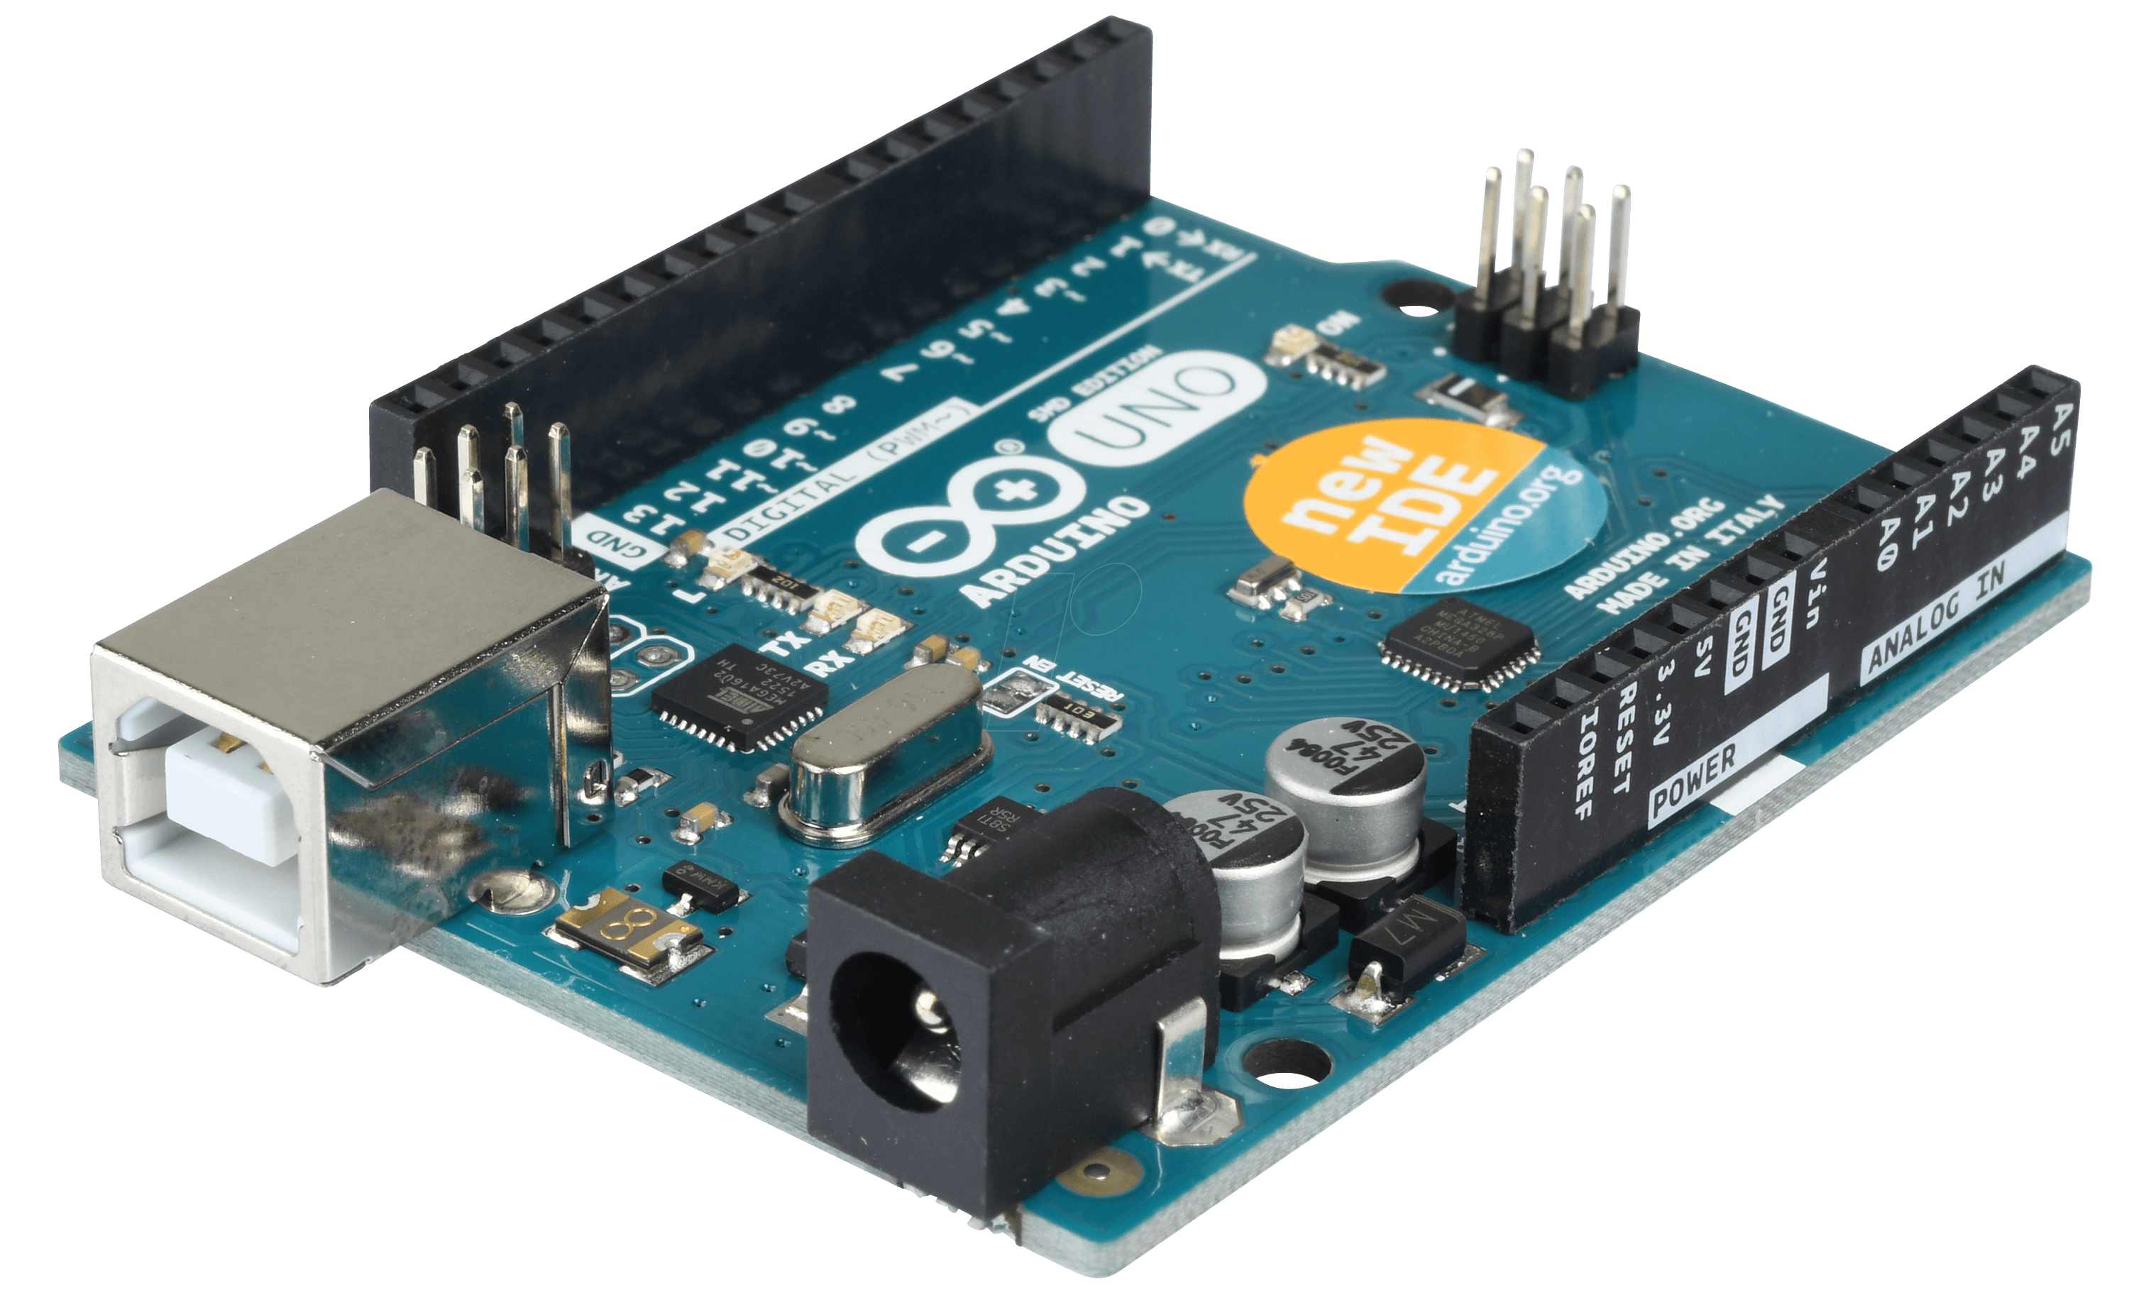
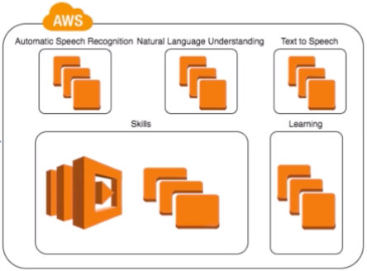


Slide 38
Step Functions
Build distributed applications using visual workflows

Slide 39
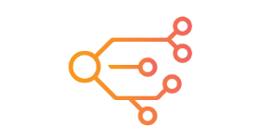
AWS Step Functions lets you coordinate multiple AWS services into serverless workflows so you can build and update apps quickly. Using Step Functions, you can design and run workflows that stitch together services into feature-rich applications. Workflows are made up of a series of steps, with the output of one step acting as input into the next. Application development is simpler and more intuitive using Step Functions, because it translates your workflow into a state machine diagram that is easy to understand, easy to explain to others, and easy to change. You can monitor each step of execution as it happens, which means you can identify and fix problems quickly. Step Functions automatically triggers and tracks each step, and retries when there are errors, so your application executes in order and as expected.

Slide 40
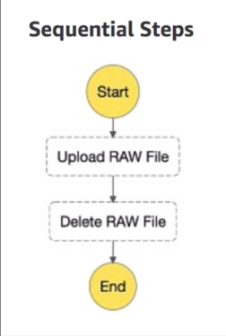
Step Functions

Slide 41
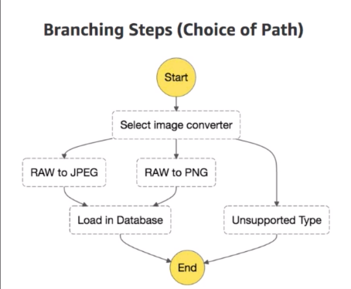
Step Functions

Slide 42
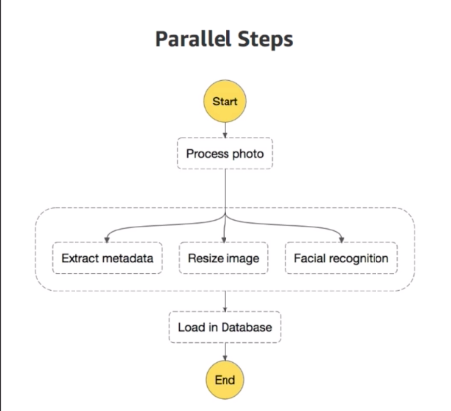
Step Functions

